Slide 1
CSC2161 Programming in C++
Dieudonne U

Slide 2

Agenda
C++ History
Variables, Operators, Expressions
Control Structures

Slide 3

C++ Programming Language
General Purpose vs Targeted
Multi-paradigm vs Single Paradigm
Compiled vs Interpreted
High Level vs Low -Level

Slide 4

General Purpose
Used to develop applications in various domains: Finance, Telecommunication, Games.
As opposed to targeted programming platforms such as MATLAB used in Engineering and Science Applications, R used in Data Science Applications..
This Photo by Unknown Author is licensed under CC BY-SA
This Photo by Unknown Author is licensed under CC BY-SA

Slide 5
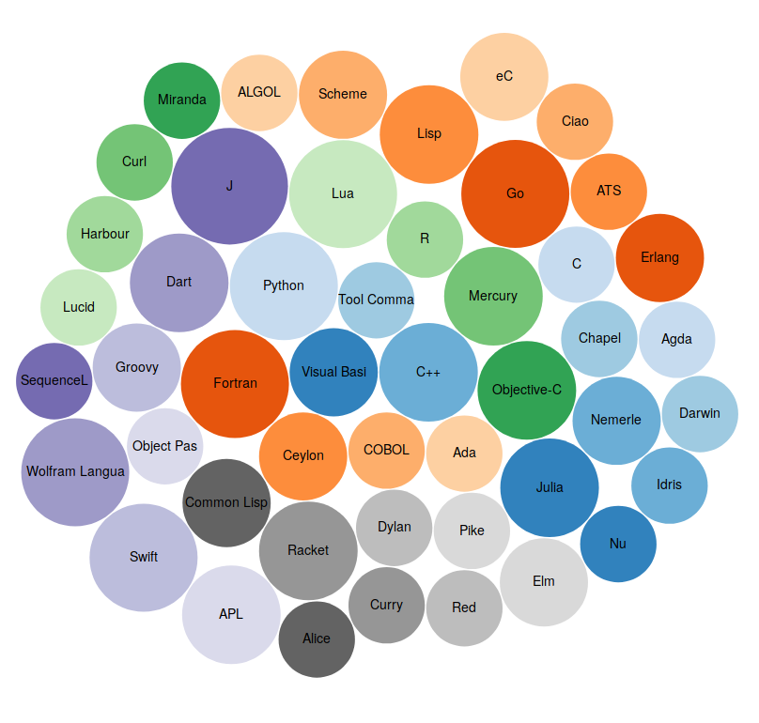
MULTI -PARADIGM
A programming paradigm is a methodology to develop computer applications.
There are many programming paradigms: Structured (Fortran, C), Functional (Haskell, Scala, Lisp), Object-oriented (Java, Python, C#), Logic (Prolog)
C++ supports many programming paradigms : Structured, Object-Oriented, Generic Programming

Slide 6
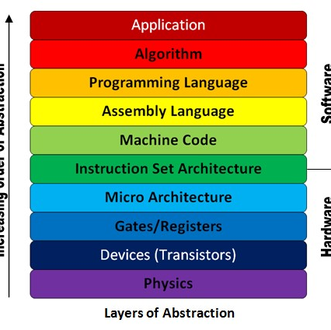
HIGH LEVEL
Machine code : Manipulated instructions in binary format, specific to each machine architecture – No abstraction
Assembly language: Uses commands to manipulate the content of registers. Converted in machine code by and assembler. Very low abstraction
High Level programing languages: programs are written in a language easier to understand by human, but not understood by the CPU. Has to be either compiled or interpreted

Slide 7


C++ Build Process
C++ Source Code
Executable file
C++ Source Files
PRE-PROCESSOR
Libraries
Intermediate Code
COMPILER
Assembler
LINKER
Assembly code
Object Code

Slide 8
History of C++
1979
Start of the development of C++ by Bjarne Stroustrup
1983
First version publicly released to the public
1998
First ISO Standard of C++
2003
Minor updates and bug fixes released
2011
Major revision of the C++ Standard Considered the beginning of Modern C++
C++98
C++03
C++11
2014
Minor revisions of C++11
Major revision of C++14
2020
Another major release
2023
Another release of the standard
2017
C++14
C++17
C++20
C++23

Slide 9
VariabLes

Slide 10
A variable is a memory location destined to hold a value
A VARIABLE HAS THE FOLLOWING PROPERTIES
Any program needs to manipulate data. Variables are the mechanism by which the program accesses and manipulates data.
Name
Value
Life time
Scope
Data type
Address

Slide 11
A DATA TYPE SPECIFIES THE RANGE OF VALUES A VARIABLE CAN HAVE AND THE OPERATIONS IT CAN BE INVOLVED IN.
Built-in data types are defined by the language
Integers: (whole numbers)short, int , long, long long.
Real numbers: (Decimal point numbers) float, double
A Single character: char
Boolean (true, false) : bool
#include <iostream>
int main()
{
std::cout << "Built- in Data types \n";
std::cout << "===========================\n";
std::cout << "size of char: " << sizeof(char) << "\n";
std::cout << "Size of short: " << sizeof(short) << "\n";
std::cout << "Size of int : " << sizeof(int) << "\n";
std::cout << "Size of long : " << sizeof(long) << "\n";
std::cout << "size of long long: "<< sizeof(long long) << "\n";
}

Slide 12
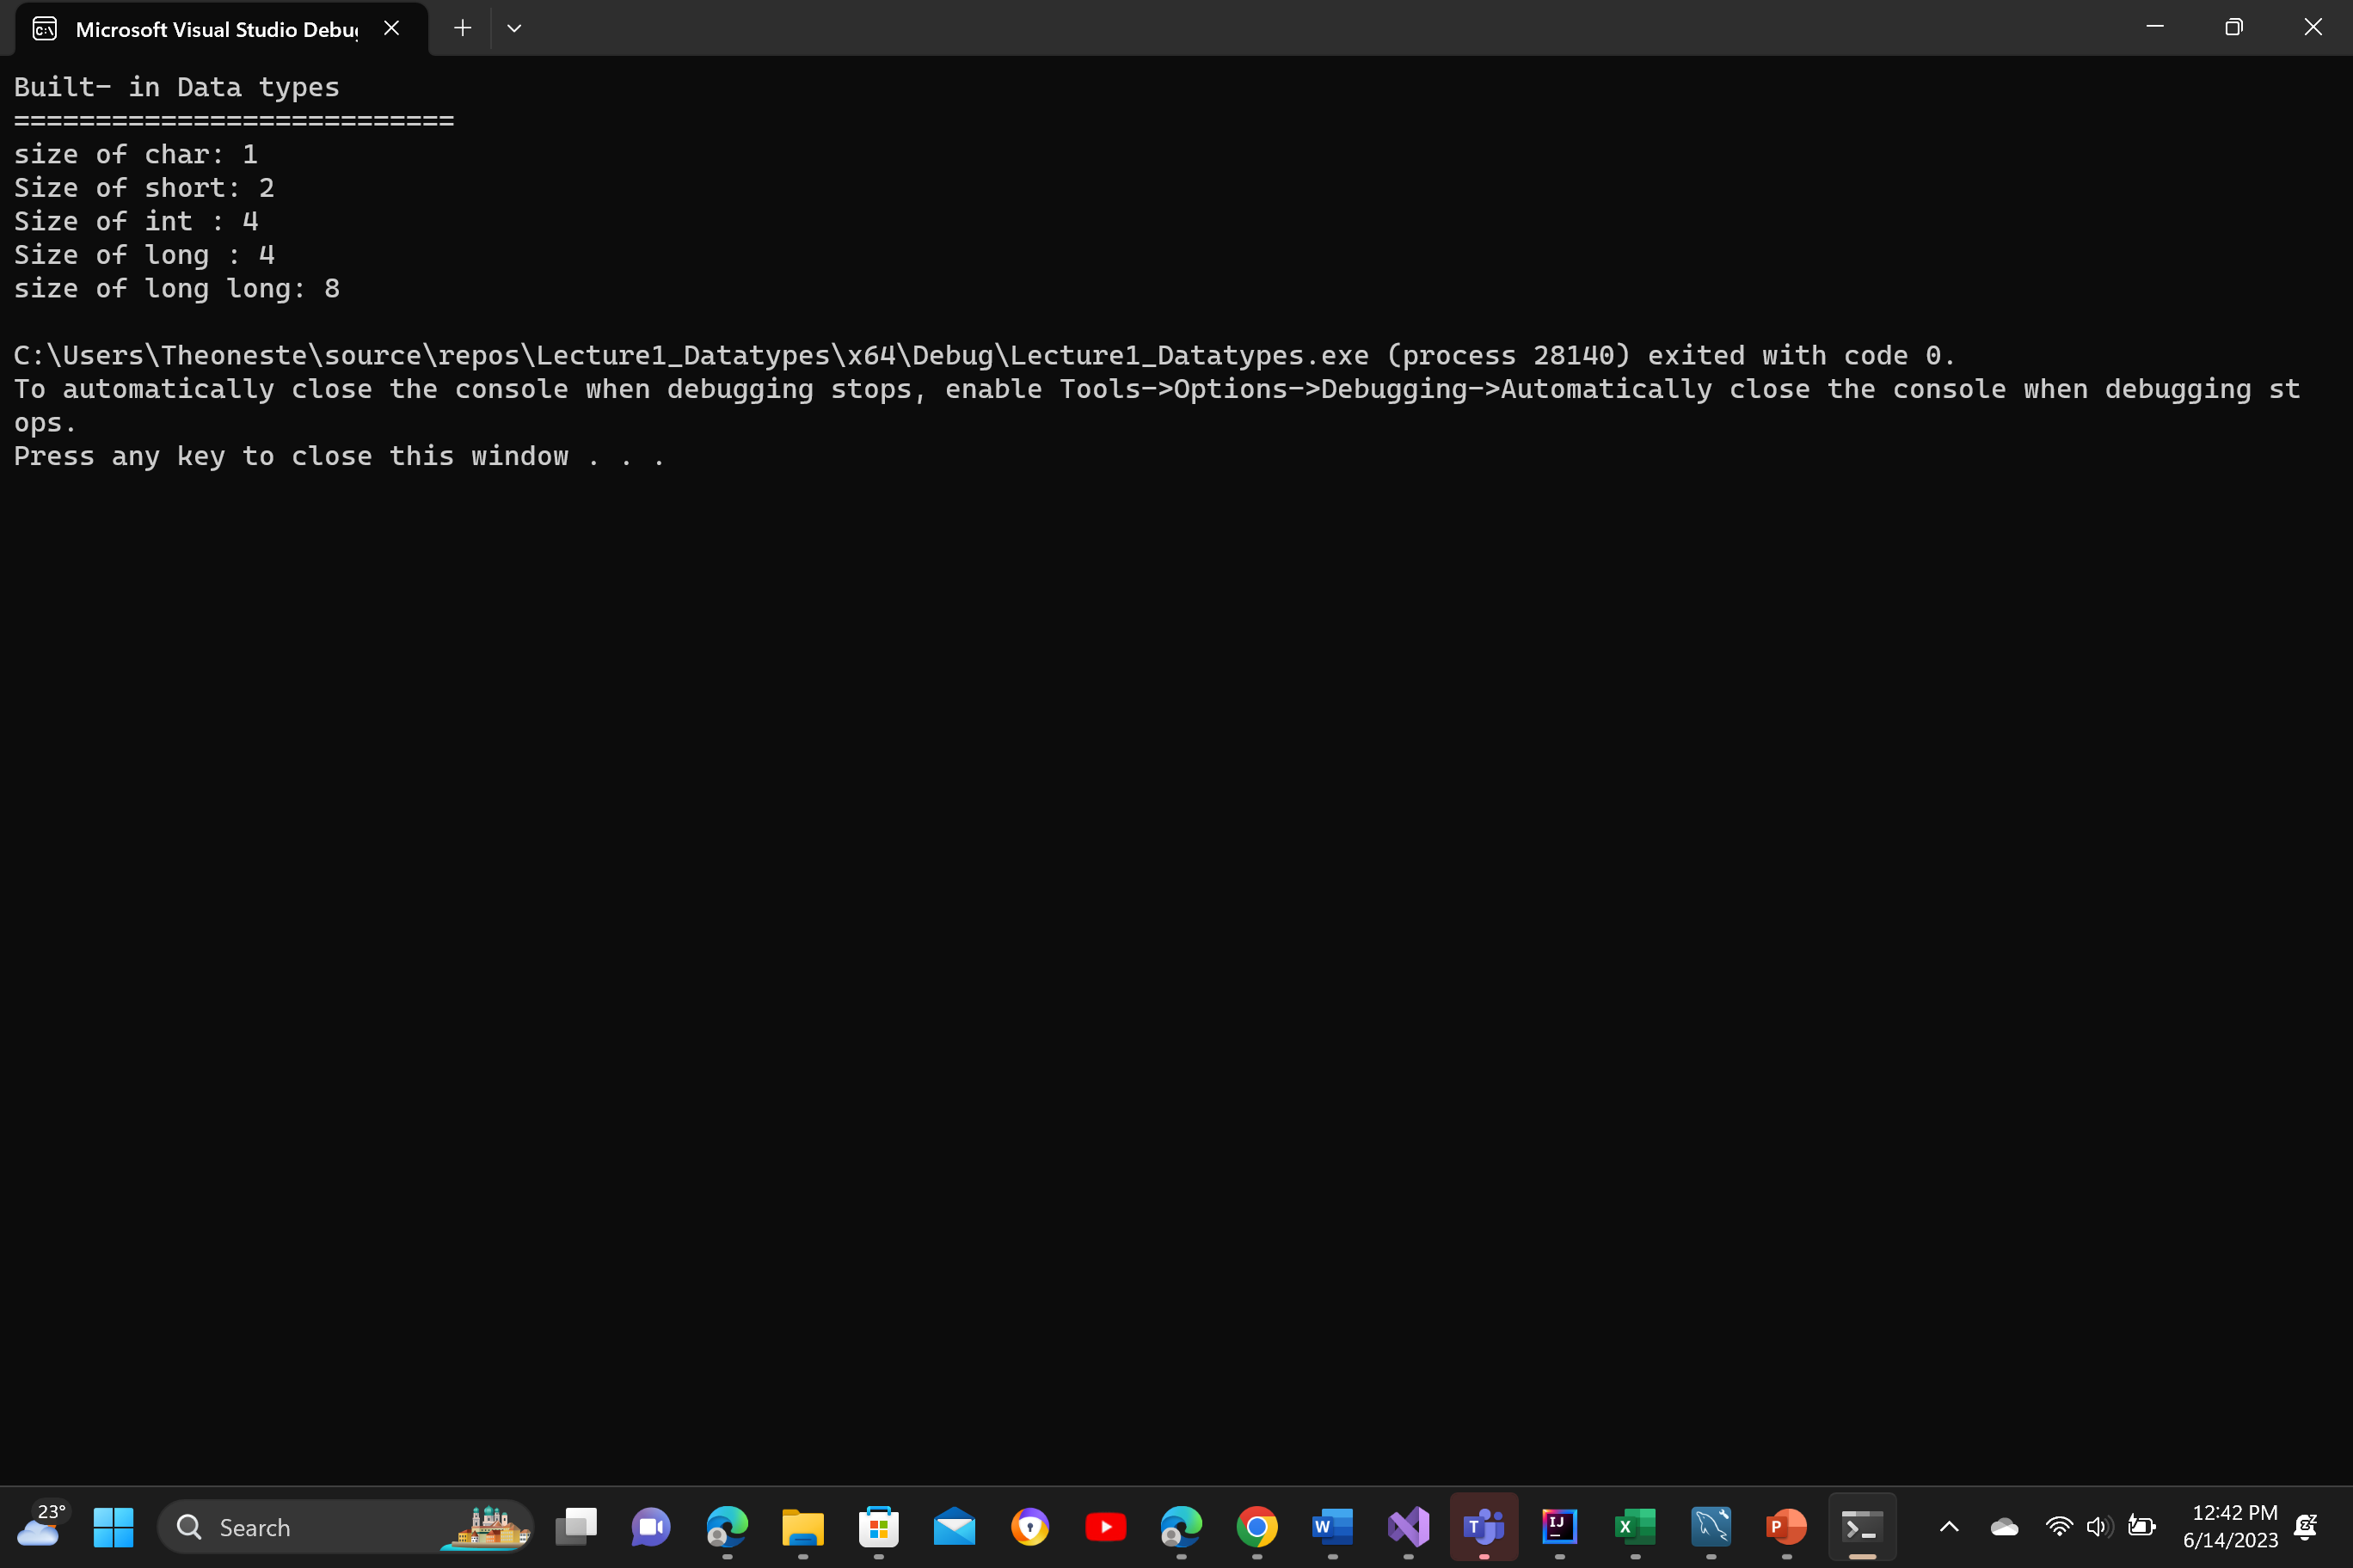
A DATA TYPE SPECIFIES THE RANGE OF VALUES A VARIABLE CAN HAVE AND THE OPERATIONS IT CAN BE INVOLVED IN.
Built-in data types are defined by the language
#include <iostream>
int main()
{
std::cout << "Built- in Data types \n";
std::cout << "===========================\n";
std::cout << "size of char: " << sizeof(char) << "\n";
std::cout << "Size of short: " << sizeof(short) << "\n";
std::cout << "Size of int : " << sizeof(int) << "\n";
std::cout << "Size of long : " << sizeof(long) << "\n";
std::cout << "size of long long: "<< sizeof(long long) << "\n";
}
Integers: (whole numbers)short, int , long, long long.
Real numbers: (Decimal point numbers) float, double
A Single character: char
Boolean (true, false) : bool

Slide 13
C++ ALLOWS USER TO DEFINE DATA TYPES => C++ IS AN EXTENSIBLE PROGRAMMING LANGUAGE.
User- Defined Data Types in C++
Derived Data types
User -Defined
Function
Array
Pointer
Reference
Class
Structure
Union
Enum
Typedef
More on this later

Slide 14
IN C++ EVERY VARIABLE MUST BE DECLARED AND INITIALIZED BEFORE BEING USED
#include <iostream>
int a = 7;
int main()
{
int b;
std::cout <<" Enter a value for b\n";
std::cin >> b;
const int c=b;
constexpr int y = 90;
return 0;
}
Declaration and intialization
Qualifier (static const, volatile,
Declaration without initialization
The value of c will not change after assignment
Constexpr introduced in C++11 Evaluated at compile time (Whenever possible )
Name
Value
constexpr int y=90;
Assignment Operator
Data Type

Slide 15
IN C++ THE NAME OF A VARIABLE CONTAINS LETTERS, DIGITS AND UNDERSCORE. IT CANNOT START WITH A DIGIT AND IT CANNOT CONTAIN A BLANK SPACE. C++ IS CASE SENSITIVE.
Key words have a specific meaning in C++, and therefore cannot be used as identifiers (name of variables or other names entities)
The same rules apply when naming functions, classes, structures, enumerations, namespaces….
https://en.cppreference.com/w/cpp/keyword

Slide 16
THE SCOPE OF A VARIABLE IS THE BLOCK IN WHICH THAT VARIABLE IS ACCESSIBLE, WITHIN A PROGRAM.
Global variable (Declared outside any function)
#include <iostream>
int a = 7;
int main()
{
int a = 8;
std::cout << " a= " << a << "\n";
std::cout << "a= " << ::a << "\n";
while (a-- > 0)
{
static int c = 1;
int d = 1;
++c;
++d;
std::cout << "c= " << c << "\t" << "d= " << d << "\n";
}
return 0;
}
Even though, it is legal, it is highly discouraged to use the same variable in different scopes of the same program
The Local Variable hides the global one (8)
Global value printed (7)
Scope resolution operator

Slide 17
THE SCOPE OF A VARIABLE IS THE BLOCK IN WHICH THAT VARIABLE IS ACCESSIBLE, WITHIN A PROGRAM.
The variables c and d are local to the while loop. The variable c is static=> It is initialized only once. When execution leaves its scope, c is inaccessible, but retains its value.
#include <iostream>
int a = 7;
int main()
{
int a = 8;
std::cout << " a= " << a << "\n";
std::cout << "a= " << ::a << "\n";
while (a-- > 0)
{
static int c = 1;
int d = 1;
++c;
++d;
std::cout << "c= " << c << "\t" << "d= " << d << "\n";
}
return 0;
}
The variable d is automatic => Every time execution leaves its scope, the variable is destroyed and recreated when execution comes back to the scope

Slide 18
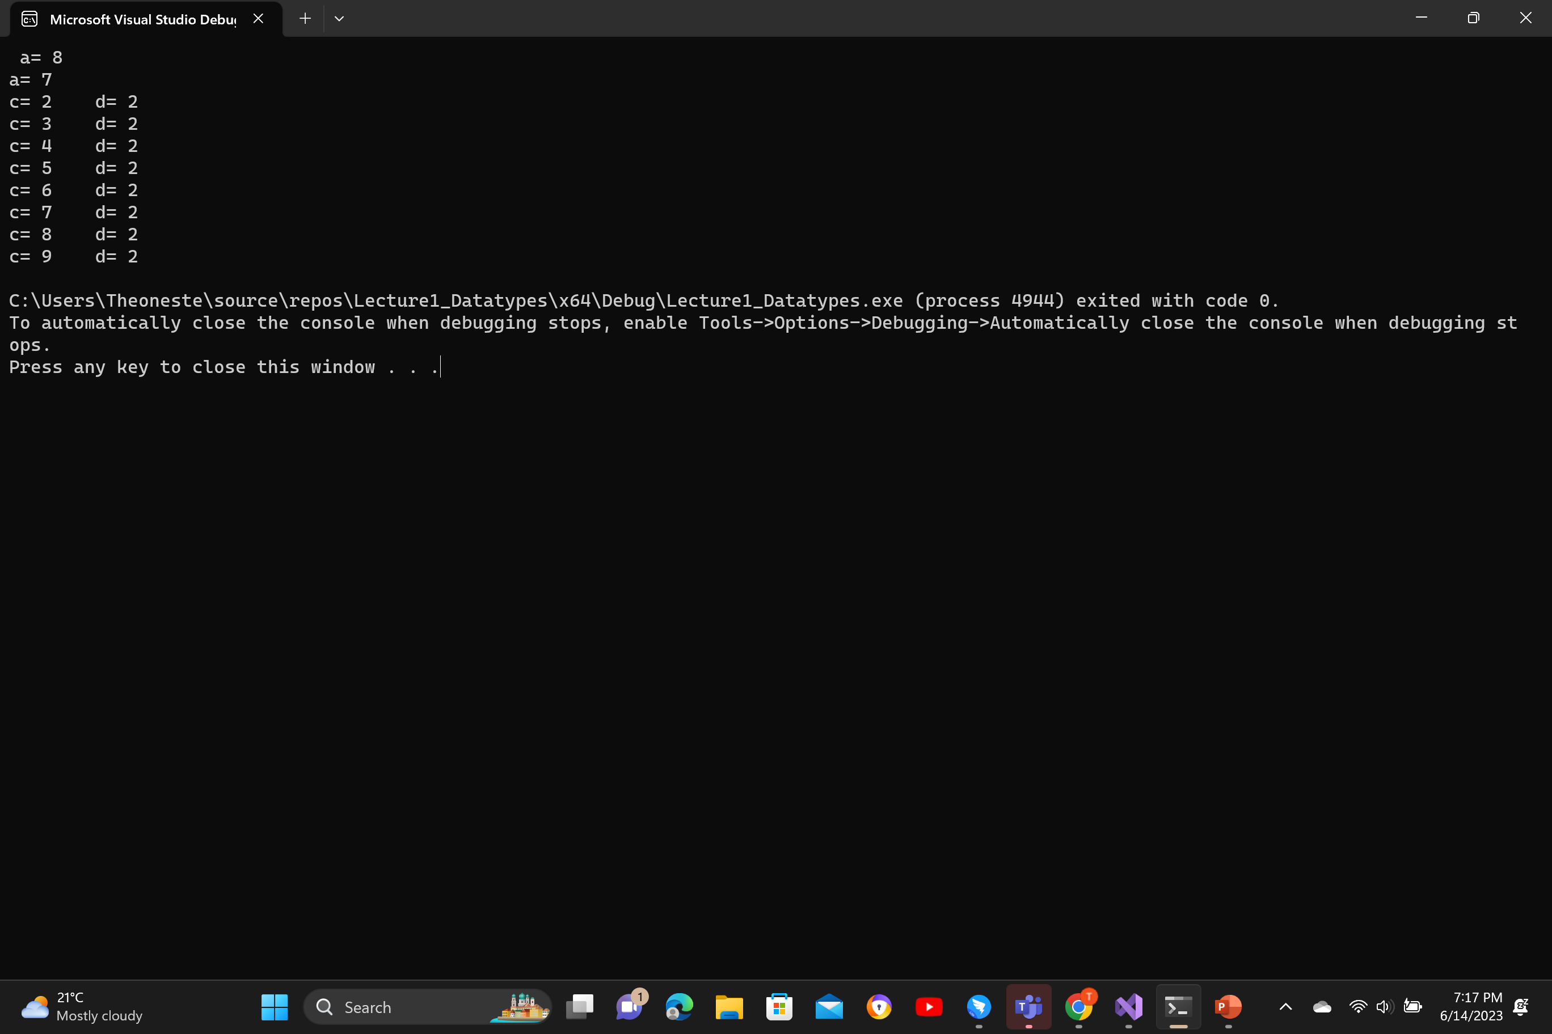
THE SCOPE OF A VARIABLE IS THE BLOCK IN WHICH THAT VARIABLE IS ACCESSIBLE, WITHIN A PROGRAM.
#include <iostream>
int a = 7;
int main()
{
int a = 8;
std::cout << " a= " << a << "\n";
std::cout << "a= " << ::a << "\n";
while (a-- > 0)
{
static int c = 1;
int d = 1;
++c;
++d;
std::cout << "c= " << c << "\t" << "d= " << d << "\n";
}
return 0;
}

Slide 19
THE SCOPE OF A VARIABLE IS THE BLOCK IN WHICH THAT VARIABLE IS ACCESSIBLE, WITHIN A PROGRAM.
Global variables and live and are accessible from the point of their declaration up to the end of the program
Life Time
Static variables live from their declaration up to the end of the program. They are not accessible outside of their scope
#include <iostream>
int a = 7;
int main()
{
int a = 8;
std::cout << " a= " << a << "\n";
std::cout << "a= " << ::a << "\n";
while (a-- > 0)
{
static int c = 1;
int d = 1;
++c;
++d;
std::cout << "c= " << c << "\t" << "d= " << d << "\n";
}
return 0;
}
Automatic local variables exist when the program execution is in their scope

Slide 20
EVERY VARIABLE HAS AN ADDRESS. C AND C++ GIVE THE PROGRAMMER DIRECT ACCESS TO THE ADDRESS OF A VARIABLE USING THE ADDRESSOF OPERATOR
#include <iostream>
int main()
{
int a = 7;
int* ptrA = &a;
std::cout << "Value of a : " << a << "\n";
std::cout << "Address of a : " << ptrA << "\n";
return 0;
}
a
7
ptrA
Address of a

Slide 21
OPERATORS

Slide 22
C++ SUPPORTS MULTIPLE OPERATORS OPERATORS ENABLE COMPUTATION
Operator | Name | Description | Example
+ | Addition | Adds together two values | x + y
- | Subtraction | Subtracts one value from another | x - y
* | Multiplication | Multiplies two values | x * y
/ | Division | Divides one value by another | x / y
% | Modulus | Returns the division remainder | x % y
++ | Increment | Increases the value of a variable by 1 | ++x
-- | Decrement | Decreases the value of a variable by 1 | --x
ARITHMETIC OPERATORS

Slide 23
RELATIONAL OPERATORS
Operator | Name | Example
== | Equal to | x == y
!= | Not equal | x != y
> | Greater than | x > y
< | Less than | x < y
>= | Greater than or equal to | x >= y
<= | Less than or equal to | x <= y

Slide 24
LOGICAL OPERATORS
Operator | Name | Description | Example
&& | Logical and | Returns true if both statements are true | x < 5 && x < 10
|| | Logical or | Returns true if one of the statements is true | x < 5 || x < 4
! | Logical not | Reverse the result, returns false if the result is true | !(x < 5 && x < 10)

Slide 25
ASSIGNMENT OPERATORS
Operator | Example | Same As
= | x = 5 | x = 5
+= | x += 3 | x = x + 3
-= | x -= 3 | x = x - 3
*= | x *= 3 | x = x * 3
/= | x /= 3 | x = x / 3
%= | x %= 3 | x = x % 3
&= | x &= 3 | x = x & 3
|= | x |= 3 | x = x | 3
^= | x ^= 3 | x = x ^ 3
>>= | x >>= 3 | x = x >> 3
<<= | x <<= 3 | x = x << 3

Slide 26
INCREMENT (DECREMENT OPERATORS CAN BE USED AS PREFIX OR POSTFIX.
Conditional (Ternary Operator)
int c = a > b ? --a : b++;
#include <iostream>
int main()
{
int a = 8;
int b = 10;
int c = a > b ? --a : b++;
std::cout << "a= " << a << "\n";
std::cout << "b= " << b << "\n";
std::cout << "c= " << c << "\n";
return 0;
}
Expression 2
Expression 1
Expression 3
If expression 1 evaluates to true, then expression 2 is evaluated, otherwise expression 3 is evaluated

Slide 27
<< >>
<< >>
PRECEDENCE OF OPERATORS DETERMINES THE ORDER OF OPERATIONS. WHEN OPERATORS HAVE THE SAME PRECEDENCE, ASSOCIATIVITY DETERMINES THE ORDER OF OPERATIONS.
* / %
+ -
<< >>
When in doubt use parentheses
https://en.cppreference.com/w/cpp/language/operator_precedence

Slide 28
C++ HAS MANY MORE OPERATORS
Function call ()
Array subscript []
sizeof operator already seen
new and delete operators
Bitwise operators
Scope resolution operator already seen
And many more…

Slide 29
TYPE CASTING CONSISTS IN CONVERTING A VARIABLE TO A DIFFERENT TYPE. C++ HAS A NUMBER OF TYPE CAST OPERATORS.
#include <iostream>
int main()
{
int number1 = 7;
int number2 = 4;
std::cout << "7/4 = " << number1 / number2 << "\n";
std::cout << "7/4 = " << static_cast<double>(number1) / number2 << "\n";
int number3 = static_cast<double>(number1) / number2;
std::cout << number3 << "\n";
return 0;
}
EXPLICIT TYPE CAST
IMPLCIT TYPE CAST
IN C++ ANY OPERATION HAPPENS BETWEEN VARIABLES OF THE SAME TYPE

Slide 30
Expression is the combination of the constants, variables, and operators, which are arranged according to the syntax of C++ language and, after computation, return some values that may be a boolean, an integer, or any other data type of C++.
An expression is a sequence of operators and their operands, that specifies a computation.
Expression evaluation may produce a result (e.g., evaluation of 2 + 2 produces the result 4) and may generate side-effects (e.g. evaluation of std::printf("%d", 4) prints the character '4' on the standard output).
Each C++ expression is characterized by two independent properties: A type and a value category.
https://en.cppreference.com/w/cpp/language/expressions

Slide 31
CONTROL STRUCTURES
DECISION CONTROL STRUCTURES

Slide 32
DECISION CONTROL STRUCTURES ALLOW PROGRAMS TO MAKE DECISIONS BASED ON SOME CONDITION. BASED ON A CONDITION THE PROGRAM SELECTS WHAT TO DO, AMONG MANY ALTERNATIVES.
#include <iostream>
int main()
{
int number;
std::cout << "Enter a positive number \n";
std::cin >> number;
if (number > 0)
std::cout << "Great you have followed the instruction\n";
return 0;
}

Slide 33
DECISION CONTROL STRUCTURES ALLOW PROGRAMS TO MAKE DECISIONS BASED ON SOME CONDITION. BASED ON A CONDITION THE PROGRAM SELECTS WHAT TO DO, AMONG MANY ALTERNATIVES.
#include <iostream>
int main()
{
int number;
std::cout << "Enter a positive number \n";
std::cin >> number;
if (number > 0)
std::cout << "Great you have followed the instruction\n";
else
std::cout << "Sorry, you did not follow the instruction\n";
return 0;
}

Slide 34
DECISION CONTROL STRUCTURES ALLOW PROGRAMS TO MAKE DECISIONS BASED ON SOME CONDITION. BASED ON A CONDITION THE PROGRAM SELECTS WHAT TO DO, AMONG MANY ALTERNATIVES.
#include <iostream>
int main()
{
int number;
std::cout << "Enter a positive number \n";
std::cin >> number;
if (number > 0)
std::cout << "Great you have followed the instruction\n";
else
std::cout << "Sorry, you did not follow the instruction\n";
return 0;
}

Slide 35
#include <iostream>
int main()
{
double cumulative_average;
char letter_grade;
std::cout << " Enter your average: \n";
std::cin >> cumulative_average;
if (cumulative_average >= 80)
letter_grade = 'A’;
else if (cumulative_average >= 70)
letter_grade = 'B’;
else if (cumulative_average >= 60)
letter_grade = 'C’;
else if (cumulative_average >= 50)
letter_grade = 'D’;
else
letter_grade = 'F’;
std::cout << "Average : " << cumulative_average << "\n";
std::cout << "Letter grade :" << letter_grade << "\n";
return 0;
}

Slide 36
SWITCH ….CASE STATEMENT WORKS IN A SIMILAR WAY AS IF ELSE IF….ELSE BUT WITH SOME RESTRICTIONS
#include <iostream>
int main()
{
int number;
std::cout << "Enter a positive integer\n";
std::cin >> number;
switch (number % 3)
{
case 0:
std::cout << number << " is divisible by 3\n";
case 1:
std::cout << "remainder is 1\n";
case 2:
std::cout << "remainder is 2 \n";
default:
std::cout << "Unkown result\n";
}
return 0;
}

Slide 37
#include <iostream>
int main()
{
int number;
std::cout << "Enter a positive integer\n";
std::cin >> number;
switch (number % 3)
{
case 0:
std::cout << number << " is divisible by 3\n";
break;
case 1:
std::cout << "remainder is 1\n";
break;
case 2:
std::cout << "remainder is 2 \n";
break;
default:
std::cout << "Unkown result\n";
}
return 0;
}

Slide 38
CONTROL STRUCTURES
REPETITION CONTROL STRUCTURES

Slide 39
IN A LOOP (REPETITION CONTROL STRUCTURE) A GROUP OF STATEMENTS IS REPEATEDLY EXECUTED, UNTIL A CONDITION IS FALSE.
#include <iostream>
int main()
{
int number;
int i = 0;
std::cout << "Enter a positive number : \n";
std::cin >> number;
while (i < number)
{
std::cout << "Hello World\n";
i++;
}
std::cout << " From Kigali\n";
return 0;
}
Assume number is 5. What will be the output of this program?

Slide 40
IN A LOOP (REPETITION CONTROL STRUCTURE) A GROUP OF STATEMENTS IS REPEATEDLY EXECUTED, UNTIL A CONDITION IS FALSE.
#include <iostream>
int main()
{
int number;
int i = 0;
std::cout << "Enter a positive number : \n";
std::cin >> number;
while (i < number)
{
std::cout << "Hello World\n";
i++;
}
std::cout << " From Kigali\n";
return 0;
}
Assume number is -1. What will be the output of this program?

Slide 41
A WHILE IS ENTRY CONTROLLED – A DO WHILE LOOP IS EXIT CONTROLLED
DO While loop executes 1 or more times
While loop executes o or more times
#include <iostream>
int main()
{
int number;
int i = 0;
std::cout << "Enter a number : \n";
std::cin >> number;
do
{
std::cout << "Hello World\n";
i++;
}while (i < number);
std::cout << " From Kigali\n";
return 0;
}
#include <iostream>
int main()
{
int number;
int i = 0;
std::cout << "Enter a number : \n";
std::cin >> number;
while (i < number)
{
std::cout << "Hello World\n";
i++;
}
std::cout << " From Kigali\n";
return 0;
}

Slide 42
A FOR LOOP HAS THREE EXPRESSIONS : INITIALIZATION , CONDITION, INCREMENT (DECREMENT)
#include <iostream>
int main()
{
int number;
std::cout << "Enter a positive number : \n";
std::cin >> number;
for(int i=0;i<number;++i)
{
std::cout << "Hello World\n";
}
std::cout << " From Kigali\n";
return 0;
}

Slide 43
A FOR LOOP HAS THREE EXPRESSIONS : INITIALIZATION , CONDITION, INCREMENT (DECREMENT)
#include <iostream>
int main()
{
int number;
int i=0;
std::cout << "Enter a positive number : \n";
std::cin >> number;
for(;i<number;++i)
{
std::cout << "Hello World\n";
}
std::cout << " From Kigali\n";
return 0;
}

Slide 44
A FOR LOOP HAS THREE EXPRESSIONS : INITIALIZATION , CONDITION, INCREMENT (DECREMENT)
#include <iostream>
int main()
{
int number;
int i=0;
std::cout << "Enter a positive number : \n";
std::cin >> number;
for(;i<number;)
{
std::cout << "Hello World\n";
++i;
}
std::cout << " From Kigali\n";
return 0;
}

Slide 45
A FOR LOOP HAS THREE EXPRESSIONS : INITIALIZATION , CONDITION, INCREMENT (DECREMENT)
#include <iostream>
int main()
{
int number;
int i=0
std::cout << "Enter a positive number : \n";
std::cin >> number;
for(; ;)
{
std::cout << "Hello World\n";
++i;
if(i>=number)
break;
}
return 0;
}
Break statement terminates the immediately enclosing loop

Slide 46
#include<iostream>
int main()
{
int number;
std::cout << "Enter a positive number : \n";
std::cin >> number;
for(int i=0;i<number;++i)
{
if (number % 2)
continue;
std::cout << number<<"\n";
}
std::cout << " From Kigali\n";
return 0;
}
Continue statement cuts short the current iteration and moves to the next.

Slide 47
#include <iostream>
int main()
{
int number=3;
while (number >= 0)
{
std::cout << number * number << "\n";
--number;
}
std:: cout <<number <<"\n";
while (number < 4)
std::cout << ++number << "\n";
std::cout << number<<"\n";
while (number >= 0)
std::cout << (number /= 2) << "\n";
return 0;
}
WHAT IS THE OUTPUT ??

Slide 48
9
4
1
0
-1
0
1
2
3
4
4
2
1
0
#include <iostream>
int main()
{
int number=3;
while (number >= 0)
{
std::cout << number * number << "\n";
--number;
}
std:: cout <<number <<"\n";
while (number < 4)
std::cout << ++number << "\n";
std::cout << number<<"\n";
while (number >= 0)
std::cout << (number /= 2) << "\n";
return 0;
}

Slide 49
#include <iostream>
int main()
{
int number=3;
while (number >= 0)
{
std::cout << number * number << "\n";
--number;
}
std:: cout <<number <<"\n";
while (number < 4)
std::cout << ++number << "\n";
std::cout << number<<"\n";
while (number >= 0)
std::cout << (number /= 2) << "\n";
return 0;
}
9
4
1
0
-1
0
1
2
3
4
4
2
1
0
9
4
1
0
0
1
2
3
4
-1
4
2
1
0

Slide 50
#include <iostream>
int main()
{
int x=10;
std::cout << --x + 1 << "\n";
std::cout << x++ << "\n";
return 0;
}
What is the ouput??

Slide 51
#include <iostream>
int main()
{
int x=1,y=2;
std::cout << x - y + 3 * 4 / 5 << "\n";
return 0;
}
What is the output??

Slide 52
#include <iostream>
int main()
{
int grade = 100;
if (grade > 60 and grade < 100)
std::cout << "Success \n";
else
std::cout << "Fail\n";
return 0;
}
What is the output??

Slide 53
#include <iostream>
int main()
{
int x = 1, y = 2;
switch (y)
{
case 1:
std::cout << "One\n";
case 2:
std::cout << "Two\n";
default:
std::cout << "Three\n";
}
return 0;
}
What is the output ??

Slide 54
#include <iostream>
int main()
{
int number_legs;
std::cout << "Enter number of legs\n";
std::cin >> number_legs;
if (number_legs == 1)
std::cout << "Pirate\n";
else if (number_legs == 2)
std::cout << "Bird\n";
else if (number_legs == 4)
std::cout << "Cat\n";
else if (number_legs == 6)
std::cout << "Spider\n";
else
std::cout << "Idon't know who you are\n";
return 0;
}
Rewrite this program using switch –case instead of if –else

Slide 55
Rewrite this program using a while loop instead of the for loop!
#include <iostream>
int main()
{
int max_number;
std::cout << "Enter max number\n";
std::cin >> max_number;
for (int i = max_number; i >= 0; i--)
std::cout << i << "\n";
return 0;
}

Slide 56
ASSIGNMENT 1 – PROBLEM 1
You own a bicycle rental business and you want to write a program that will help you determine what your customers will have to pay you for a rental. You are going to provide two integers as input. The first integer represents the starting time (hour) and the second integer represent the ending time (hour). Decimal numbers are not accepted.
(1) The starting time will always be less than the ending time. Also no rental can span more than a day. The start time will be between 0 and 23 and the ending time will be between 1 and 24.
(2) The rate per hour depends on the range as follows :
0 - 7 and 21- 24 : the rent will be 500 RWF per hour
7-14: and 19h-21: rent will be 1000 RWF per hour
14-19 : the rent will be 1500 RWF per hour
Write a C++ Program that implements the above bicycle rental program

Slide 57
ASSIGNMENT 1 PROBLEM 2
The cepe bordeaux is the only one to have pores, the other mushrooms having gills.
Both coprin chevelu and agaric jaunissant grow in meadows, other mushrooms grow in forests.
Mushrooms
The only mushrooms to have a convex cup are agaric jaunissant,amanite tue-mouches, and pied bleu.
The only mushrooms to have a ring are agaric jaunissant,amanite tue-mouches, and coprin chevelu
Agaric Jaunissant
Amanite tue-mouche
Cepe de bordeau
Coprin chevelu
Girolle
Pied bleu

Slide 58
ASSIGNMENT 1 PROBLEM 2 (Cont…)
Does your mushroom have gills ?
Does your mushroom grow in a forest ?
Does your mushroom have a ring?
Does your mushroom have a convex cup?
The User thinks of a mushroom (one of the six).
The program asks at most three of the four questions
The User answers truthfully by yes or no.
Based on the user’s answers, the program determines the mushroom
Write a C++ Program that implements this scenario.

Slide 59




Thank you
Presenter name
Email address
Website

